Slide 1


Graham Consulting Group Partnered with Kickstarter

Slide 2




Slide 3

MSCA 31008 DATA MINING PRINCIPLES
Divya Ravindran
Niharika Tyagi
Radhika Gehlot
Rebha Adyanthaya
Sapna Mishra

Slide 4






Agenda
Overview
Executive Summary
Analysis
- Preliminary Data Analysis
- Exploratory Data Analysis
- Feature Engineering
Models and Predictions
Cost & Benefits
Recommendations
Future Work
Q & A

Slide 5


Executive summary: This project collated and analyzed Kickstarter Campaign data to construct a model that would predict the success or failure of a campaign at launch time.
Stakeholder :
Business Goal : Help Kickstarter increase revenues by identifying successful campaigns
Problem : High Failure Rate

Slide 6



Founded in 2009
18 m
Backers
178,868
Projects successfully funded
$4.8 billion
Pledged
Mission : Help bring creative projects to life

Slide 7
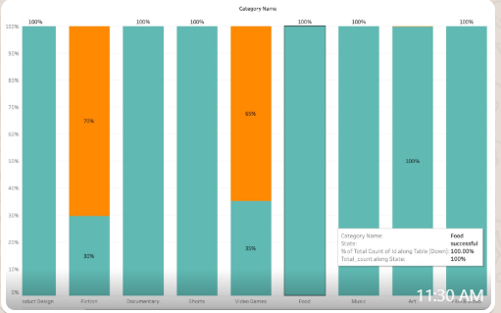



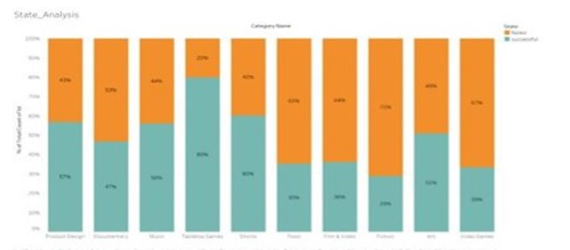


Preliminary Data Analysis
Date Range :
2009 - 2020
File Size : 52 GB
Data Size :
Rows : 464,241
Columns : 22

Slide 8
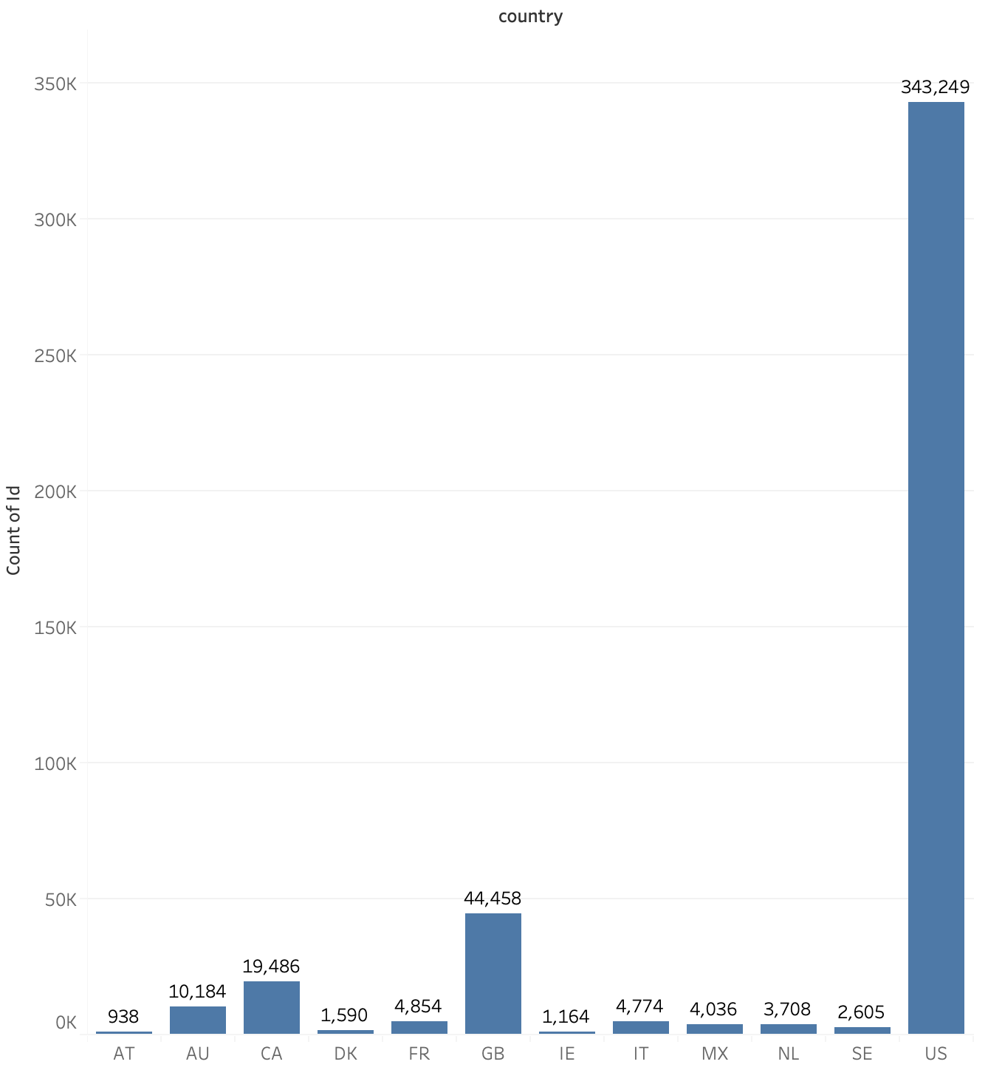
Kickstarter Data
Data Set Includes USA with an overall conversion rate of 45.23%
45.23%
Conversion Rate

Slide 9
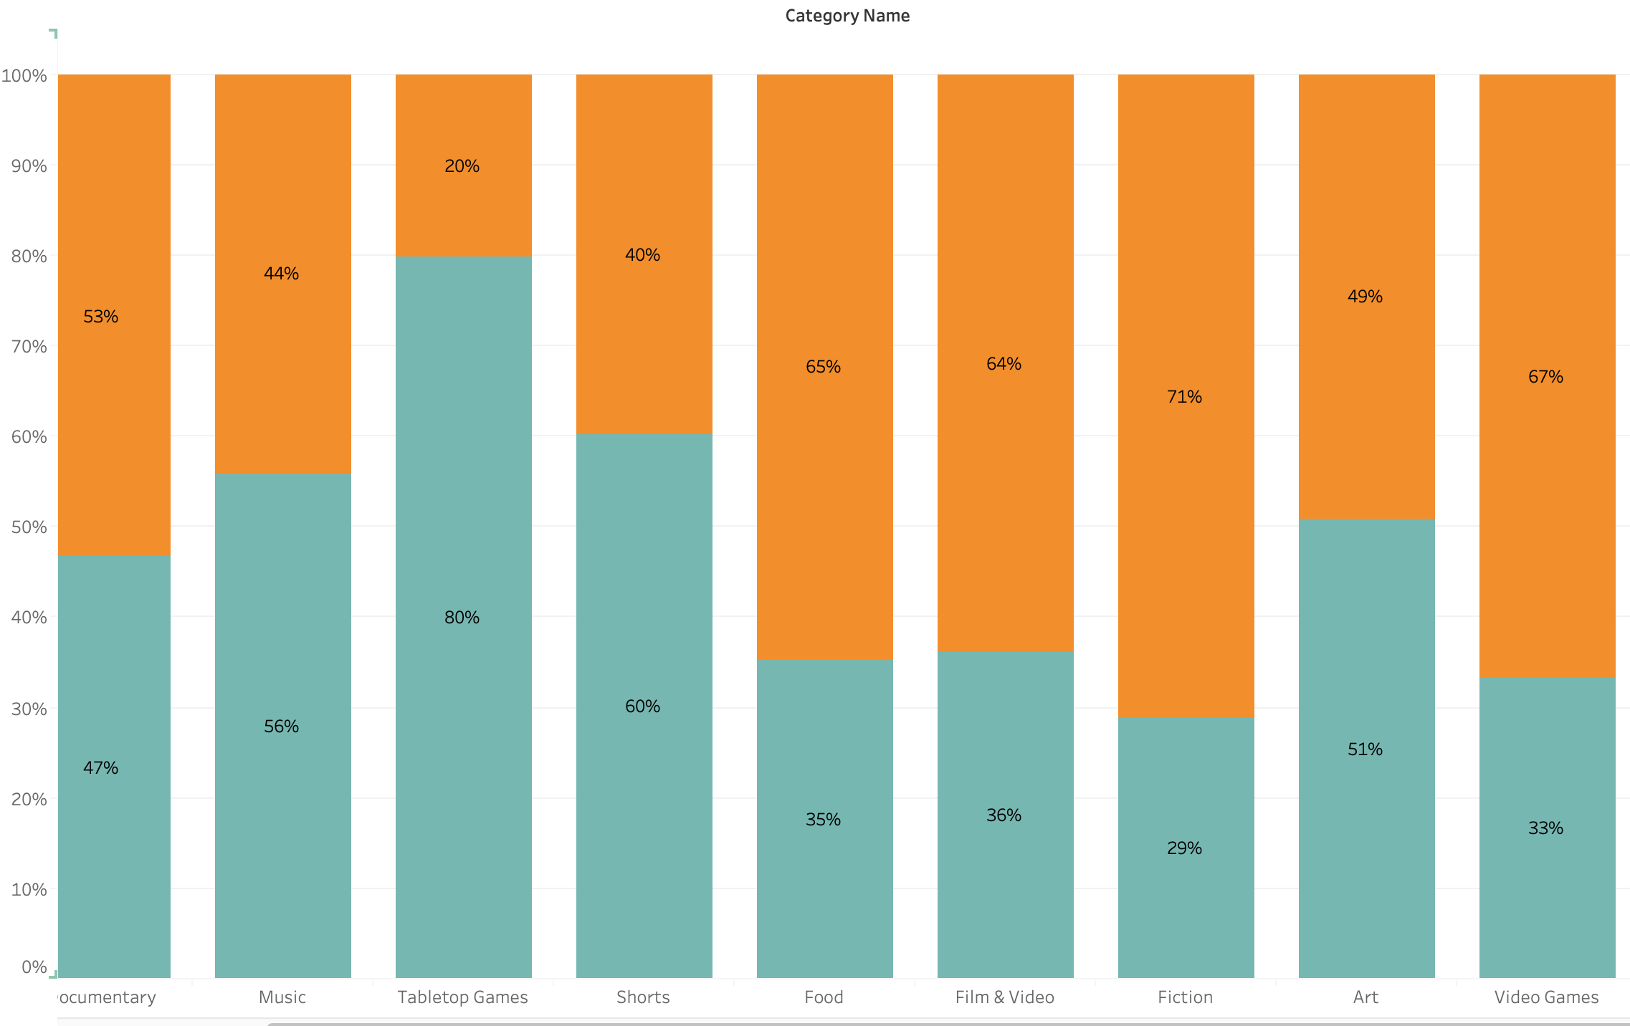
Proportion of Successful projects within Main Categories balances around 45% Variation in the conversion rate seen across Quarters

Slide 10
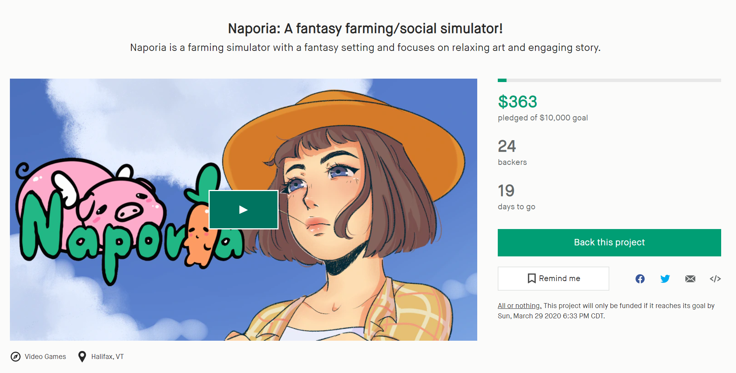

Feature Engineering
Name Length
Campaign Name
Word
Count
Name
With !
Name
With ?
Backers Count
Age
Create Date
Quarter
Participant/Quarter
Day

Slide 11

Task
Success Prediction
Method
- Logistic Regression
- Random Forest
- Boosting Models
- Stack/ensemble models
Performance measure
Precision, Recall, F1 score
AUC
Methods & Performance

Slide 12
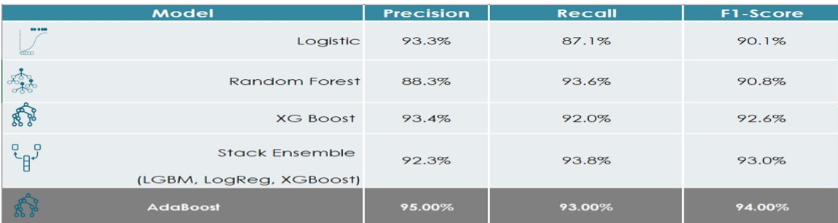
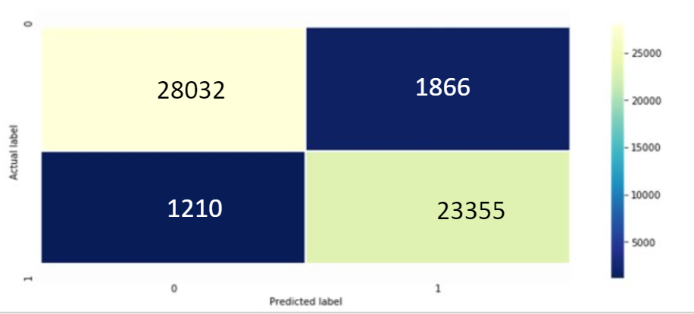
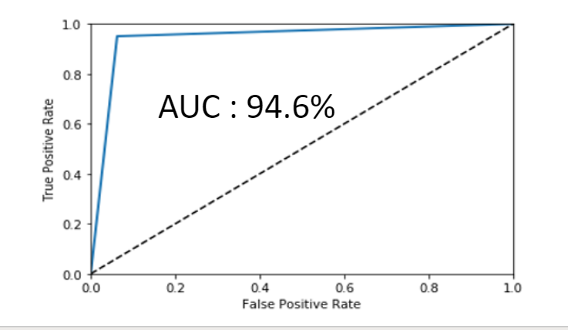
Ensemble models were able to predict slightly better than standalone models

Slide 13
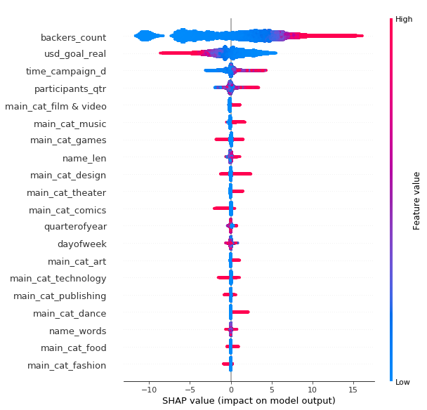
SHAP plots show backers count, goal amount and participant quarter are important features with highest predictive power
While Backers count & participant quarters have a positive impact, goal amount has a negative impact on success
Kickstarter category and features derived from Kickstarter name are important predictors as well

Slide 14
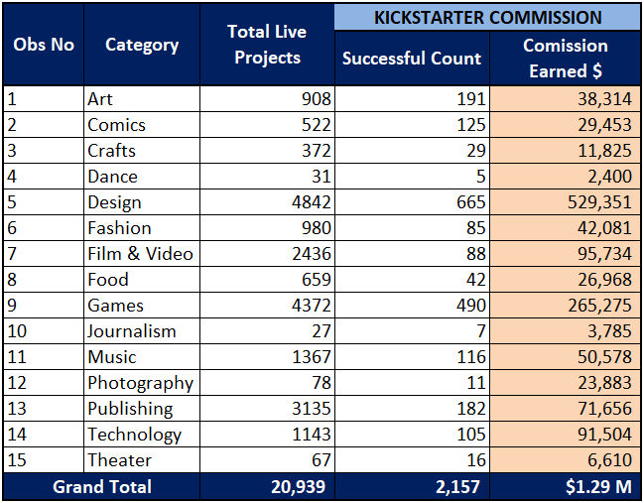



Cost and Benefits: Predictions on 'Live Campaigns' using the Adaptive Boosting Model
Total Live Campaigns as of Feb 2020:
20,939
$ 1.29M
10% Predicted Successful :
2,157

Slide 15
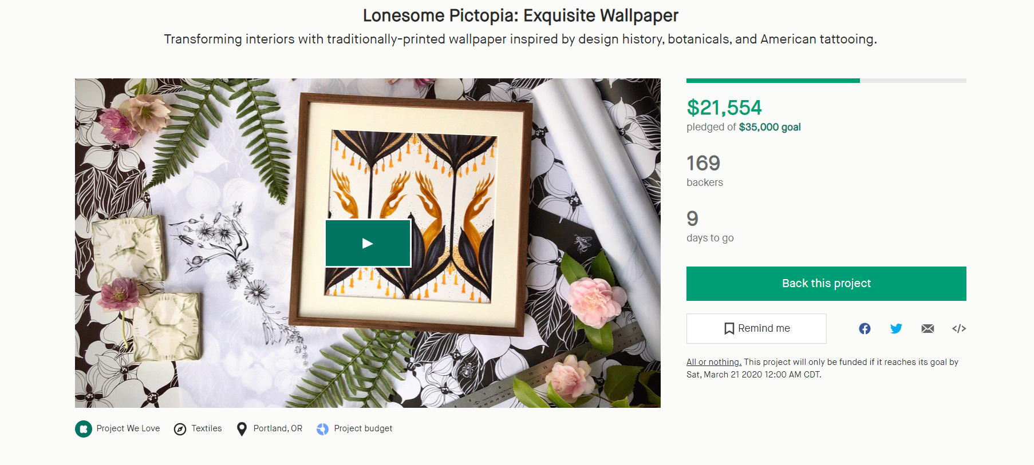
Immediate Action

Slide 16
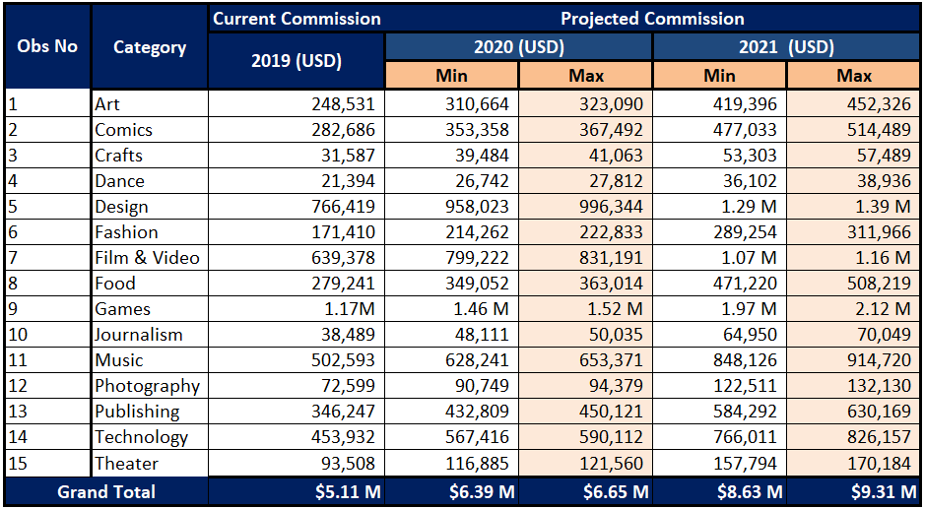

Model deployment will generate a Potential Value of $9.31M
25%
$ 9.31M

Slide 17



Potential Predictors:
Creator identity-Individual/Team/Organization
Kickstarter verified
Profit/Non-profit cause
Click/View
Better classification of sub-categories
Help campaign creators to launch successful project
Recommendations

Slide 18




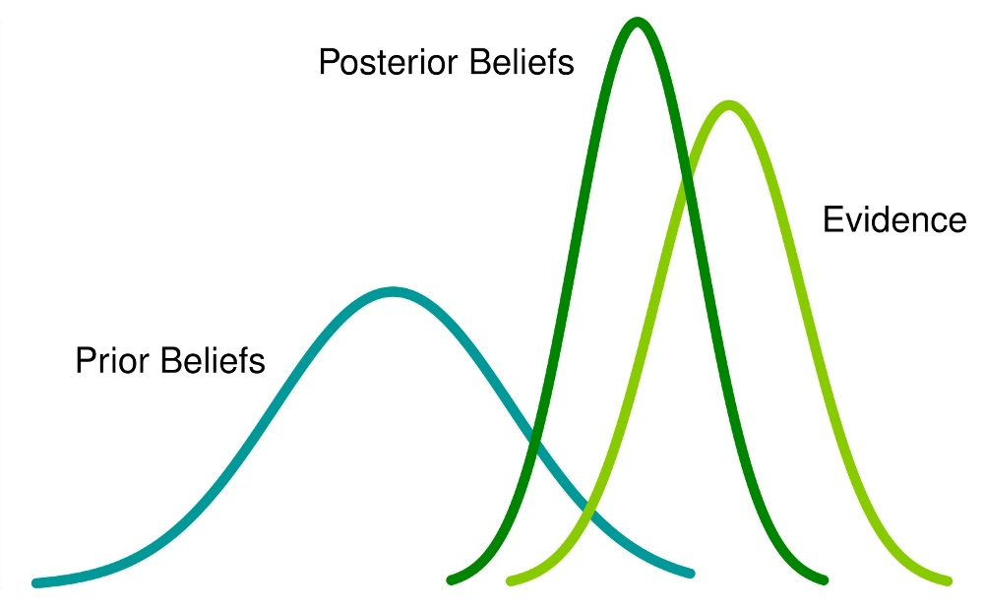

Web scrapping​
Use json files instead of csv​
Sentiment analysis/ Text mining on features like 'blurb' and 'name'
Better business models post discussions with Kickstarter Team
Prediction using Random effect Bayesian models
Generate new features from 'Comments'
Future Work

Slide 19


